Slide 1
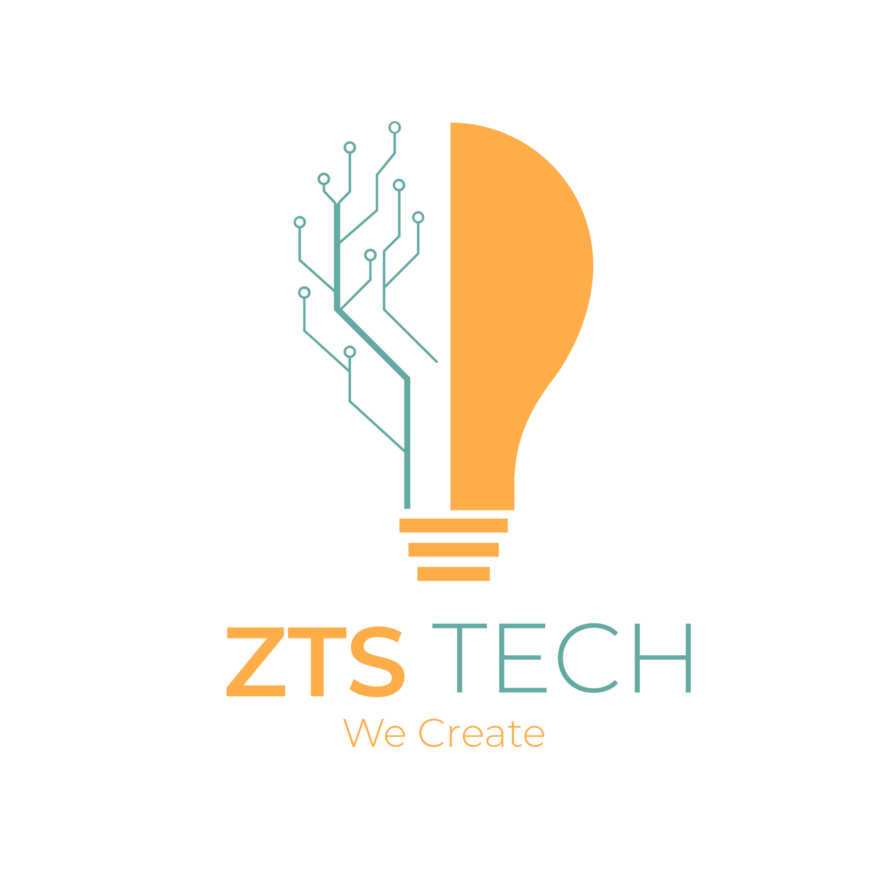

Slide 2



"RAMBUL: A MOBILE APPLICATION ENHANCING MOTORCYCLE TRANSPORTATION SERVICES FOR EFFICIENT TRAVEL IN BUTUAN CITY"
Salazar, Jeza Mae
Sarigumba, Ron Albert
Tutor, John Mhico

Slide 3
OVERVIEW
RELATED WORKS
PROBLEM OF THE STUDY
OBJECTIVE OF THE STUDY
SCOPE AND LIMITATIONS
TECH STACKS

Slide 4
RELATED WORKS
According to Bausch and Mesarovic (2018), Motorcycle taxis are affordable and efficient transportation options, favored for their ability to navigate congested urban areas. Factors influencing user adoption include perceived usefulness, subjective norms, risk, playfulness, and price level (Lim et al., 2018). Convenience, cost-effectiveness, reliability, service quality, and trust are significant determinants of continued usage (Zou et.al, 2021). Hochmuth (2016) analyzed the ride-hail app wars, highlighting the impact of vehicle selection on customer satisfaction, despite ride-hailing platforms prioritizing factors like distance, availability, and cost over individual preferences for features or amenities.However, research on integrating ride-hailing apps into sustainable transportation plans is lacking (Chalermpong et al., 2023).
The literature gaps exist in analyzing the challenges of expensive and time-consuming taxi travel, especially during rush hours and congested traffic. Additionally, research is lacking on the limitations of the fixed-route jeepney system and the lack of motorcycle choice for users. Further investigation is needed to explore motorcycle ride-hailing services' potential in offering affordable and efficient urban mobility solutions.

Slide 5

PROBLEM OF THE STUDY
Lack of affordable and efficient transportation options in Butuan City that provide direct access to desired locations.
Slow travel times and inconvenience, especially when using taxis.
Rigid routes of the current jeepney system, limiting accessibility to specific locations.

Slide 6
OBJECTIVE OF THE STUDY
To develop a mobile application, Rambul, that provides efficient motorcycle ride-hailing services in Butuan City, offering an affordable and time-saving alternative to conventional four-wheel vehicle transportation options.
To develop a mobile application, Rambul, that provides door-to-door motorcycle ride-hailing services in Butuan City, ensuring convenient and direct transportation for users to their specific destinations within the city.
To introduce Rambul, a motorcycle service ride-hailing platform, to our city, that will give convenience to the users even in the small area where 4 wheels cannot enter.
To develop a ride-hailing application that empowers users to select their desired motorcycle for their transportation needs.

Slide 7

SCOPE AND LIMITATION
SCOPE
LIMITATION
The scope of the Rambul project is to develop motorcycle ride-hailing services in Butuan City, focusing on door-to-door transportation. It involves creating a user-friendly mobile app for calling riders, monitoring their arrival, and enabling real-time tracking. The project also emphasizes the implementation of efficient ride-matching algorithms and compliance with local laws and regulations governing motorcycle ride-hailing services.
The limitation of the Rambul application is its dependency on motorcycle availability and rider participation, requiring a sufficient number of active riders. Additionally, a reliable internet connection is crucial for real-time location updates, which may be challenging in areas with limited or unreliable connectivity.

Slide 8
TECH STACKS
Unity Engine: Unity is needed to create the user interface, handle graphics rendering, and manage the overall application logic. It provides a powerful development environment for creating interactive and visually appealing applications.
Node.js: Node.js is a backend framework that enables server-side logic, handling data management, and facilitating real-time communication. It is useful for managing user requests, coordinating data exchanges, and ensuring a smooth experience for users and drivers.
Google Maps API: The Google Maps API is crucial for integrating mapping and geolocation services into your application. It enables features such as real-time location tracking, route planning, and distance calculation, which are essential for providing accurate navigation and optimizing the ride-hailing experience.

Slide 9



“BRONXDER: ENHANCING ORDER MANAGEMENT EFFICIENCY AND CUSTOMER EXPERIENCE THROUGH A TABLET-BASED ORDERING SYSTEM AT BRONX CAFE"
Salazar, Jeza Mae
Sarigumba, Ron Albert
Tutor, John Mhico

Slide 10
OVERVIEW
RELATED WORKS
PROBLEM OF THE STUDY
OBJECTIVE OF THE STUDY
SCOPE AND LIMITATIONS
TECH STACKS

Slide 11

RELATED WORKS
Multiple studies have examined the adoption and impact of tablet-based ordering systems in restaurants. They identified factors influencing adoption (Huang et.al, 2019), improved order-taking efficiency (Gao and Bai, 2014), advantages and challenges (Raza et.al, 2019), customer intentions (Xiao et.al, 2018), menu design effects (Ryu and Jang, 2017), customer satisfaction (Hasan et.al, 2019), intention factors (Tu and Chen, 2019), impact on restaurant performance (Cho et.al, 2016), service quality (Wang and Park, 2019), and the effect of different menu types (Go and Lee, 2017).
Existing studies indicate that table-based ordering systems have been implemented in certain establishments in cities. However, it is common for waiters to carry the ordering device, necessitating customers to call them to place their orders.

Slide 12
PROBLEM OF THE STUDY
The need for a solution to streamline order management, enhance communication, and optimize the overall ordering process for improved customer satisfaction and operational effectiveness.
Lack of real-time order visibility and effective communication between stakeholders.
Challenges caused by the absence of a tablet-based ordering system, including delays in order transmission, potential order fulfillment mistakes, and limited tracking of order status.

Slide 13
OBJECTIVE OF THE STUDY
Develop the Brxder tablet-based ordering system: Create a user-friendly and intuitive tablet application that allows customers to browse the menu, select items, customize orders, and submit them digitally.
Improve operational efficiency: Increase the efficiency of the order management process, reducing wait times, minimizing errors, and optimizing resource allocation.
To propose the tablet-based ordering system to be built-in: To solve the problem of staff bringing the device that tends the customers to call them to make an order.

Slide 14

SCOPE AND LIMITATION
SCOPE
LIMITATION
The project scope involves developing and implementing the Brxder tablet-based ordering system at Bronx Cafe. It aims to streamline order management and enhance customer experience. This includes creating a user-friendly tablet application for digital order submission and customization. Integration with the existing cashier display system is planned to facilitate efficient order processing. Additionally, the scope encompasses testing, staff training, and deploying the system within Bronx Cafe's premises.
The application requires stable network access, excluding advanced features like inventory management. Hardware and software limitations may impact system performance. The device usage is limited to the store premises due to modifications. Assumptions are made about the cashier display system's capability, with modifications falling outside the project scope.

Slide 15
TECH STACKS
Unity with Firebase Realtime Database: Unity with Firebase Realtime Database for real-time synchronization of orders between tablets, cashiers, and the kitchen.
Unity with RESTful API: Unity with a RESTful API for communication between tablet orders, cashiers, and the kitchen.
Unity with WebSocket: Unity with WebSocket for real-time order transfer and communication between tablets, cashiers, and the kitchen.

Slide 16



"TRAFFIC SIGN QUIZ: A MOBILE GAME APPLICATION WITH IMAGE RECOGNITION FOR TL MABUHAY DRIVING LESSON ACADEMY INC."
Salazar, Jeza Mae
Sarigumba, Ron Albert
Tutor, John Mhico

Slide 17
OVERVIEW
RELATED WORKS
PROBLEM OF THE STUDY
OBJECTIVE OF THE STUDY
SCOPE AND LIMITATIONS
TECH STACKS

Slide 18
RELATED WORKS
Proper knowledge and adherence to traffic signs and regulations reduce accidents (Nagar 2022). Pakistan's lack of professional driver training increases the risk of road traffic accidents (Hussain & Shi, 2019). Purnamasari (2019) found that violations still occurred despite a good understanding of 32 traffic signs (77.11% correct). Hassan et.al (2022) noted low awareness (43%) of traffic signs, influenced by age, education, and driving experience. Borrego-Jaraba et al. (2020) propose a gamified approach for road sign recognition, while Tran and Tran (2020) suggest a mobile-based system with deep learning algorithms. Barmpounakis et.al (2019) implement a mobile game with CNN models for real-time sign recognition. Li et.al (2017) integrate sign recognition technology into a game-based app. Ertan (2020) trains a CNN model for real-time sign recognition on a mobile device.
Previous research has proposed gamification to emphasize traffic sign importance. However, there is a need to enhance knowledge and training on traffic signs. To fill this gap, pre-assessments can improve users' understanding and retention of traffic sign knowledge.

Slide 19
PROBLEM OF THE STUDY
Lack of knowledge and understanding of traffic signs among individuals.
Ineffectiveness and lack of engagement with traditional learning methods.
The need for an interactive tool to aid in memorizing and comprehending traffic signs.

Slide 20
OBJECTIVE OF THE STUDY
Create a mobile game application called "Traffic Sign Quiz" that tests players' knowledge of traffic signs.
Create a mobile game application with an image recognition feature that can enhance their knowledge of traffic signs.
To evaluate the effectiveness of the application by conducting a pretest before using the application and conducting a post-test after using the application.

Slide 21

SCOPE AND LIMITATION
SCOPE
LIMITATION
This study focuses on developing and evaluating the effectiveness of the "Traffic Sign Quiz" game as a tool for improving users' recognition and understanding of traffic signs. The scope includes designing an interactive game using image recognition technology to detect and identify traffic signs in real-life scenarios. The study will assess users' performance and gather feedback to evaluate the game's impact on users' knowledge and preparedness for the LTO licensing exam.
The limitation of the "Traffic Sign Quiz" game is its reliance on image recognition technology, which may be affected by variations in lighting conditions, image quality, and occlusions. This can result in challenges and potential inaccuracies in correctly identifying and recognizing traffic signs, leading to misleading learning experiences for users.

Slide 22
TECH STACKS
Unity with OpenCV: OpenCV integration in Unity for powerful image processing capabilities.
Unity with Firebase ML Kit: Firebase ML Kit integration in Unity for ready-to-use image recognition features. Unity with Custom.
.
Machine Learning Models: Create and integrate custom machine learning models in Unity for tailored image recognition functionality.

